Slide 1
Message Authentication and Hash Functions

Slide 2
Authentication & Digital Signature
Authentication
  Message came from the alleged source
  Have not been modified
Digital Signature
  Authentication Technique
  measure to counter Repudiation
  (in source and Destination)

Slide 3
Message Authentication
message authentication is concerned with:
  protecting the integrity of a message
  validating identity of originator
  non-repudiation of origin (dispute resolution)
three alternative functions used:
  message encryption
  message authentication code (MAC)
  hash function
Notes:
Up untill now, have been concerned with protecting message content (ie secrecy) by encrypting the message. Will now consider how to protect message integrity (ie protection from modification), as well as confirming the identity of the sender. Generically this is the problem of message authentication, and in eCommerce applications is arguably more important than secrecy. Message Authentication is concerned with: protecting the integrity of a message, validating identity of originator, & non-repudiation of origin (dispute resolution). There are three types of functions that may be used to produce an authenticator: message encryption, message authentication code (MAC), or a hash function.

Slide 4
Authentication Requirements
Attacks on network communication
  Disclosure(shown message)
  Traffic analysis(frequency and duration)
  Masquerade(insertion of message)
  Content modification
  Sequence modification
  Timing modification
  Source repudiation(transmission message)
  Destination repudiation(receipt message)

Slide 5
Authentication Function
Message Encryption
  Cipher Text : provide Authentication
  symmetric/Public-key Encryption
Message Authentication Code(MAC)
  Append small fixed-size block data
Hash function
  Variable-length Message→fixed-length hash value

Slide 6
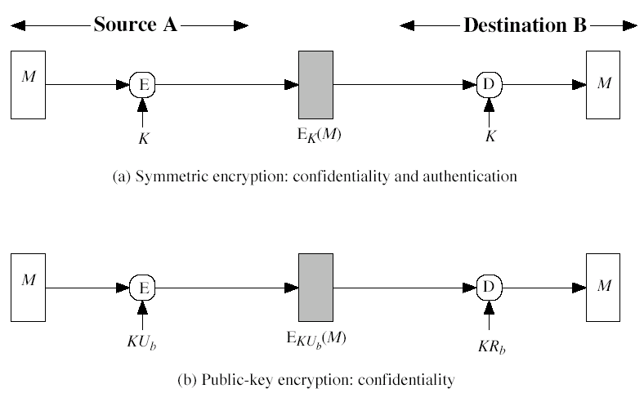
Basic Use of Message Encryption

Slide 7
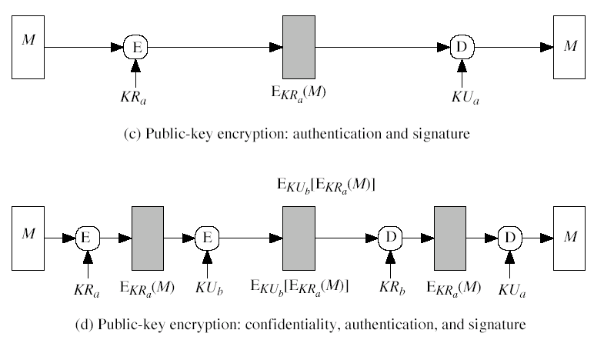
Basic Use of Message Encryption

Slide 8
Message Encryption Summary
Symmetric Encryption
  confidentiality and authentication
Public-Key Encryption
  Confidentiality
  Authentication and signature
  Authentication and signature and Confidentiality

Slide 9
Message Authentication Code (MAC)
a small fixed-sized block of data:
  depends on both message and a secret key
  like encryption though need not be reversible
appended to message as a signature
receiver performs same computation on message and checks it matches the MAC
provides assurance that message is unaltered and comes from sender
Notes:
An alternative authentication technique involves the use of a secret key to generate a small fixed-size block of data, known as a cryptographic checksum or MAC that is appended to the message. This technique assumes that two communicating parties, say A and B, share a common secret key K. A MAC function is similar to encryption, except that the MAC algorithm need not be reversible, as it must for decryption.

Slide 10
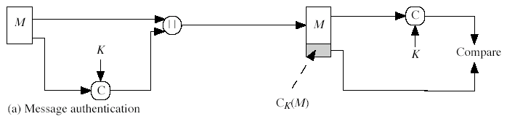
Basic Use of MAC
  A → B : M ||C_{K}(M )
  provides authentication
    Only A and B share K

Slide 11
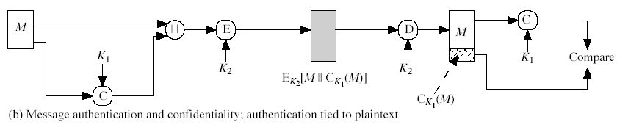
Basic Use of MAC
  A → B : E_{K2}[M ||C_{K1}(M )]
  provides authentication
    Only A and B share K₁
  provides confidentiality
    Only A and B share K₂

Slide 12
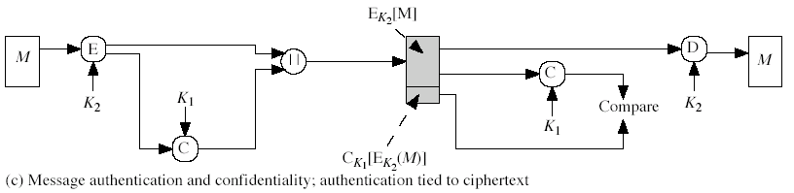
Basic Use of MAC
  A → B : E_{K2}[M ]||C_{K1}[E_{K2} [M ]]
  provides authentication
    Using K₁
  provides confidentiality
    Using K₂

Slide 13
Message Authentication Codes
MAC provides authentication
Message can be encrypted for secrecy
  generally use separate keys for each
  can compute MAC either before or after encryption
  is generally regarded as better done before
why use a MAC?
  sometimes only authentication is needed
  sometimes need authentication to persist longer than the encryption (e.g., archival use)
note that a MAC is not a digital signature
Notes:
Can combine use of MAC with encryption in various ways to provide both authentication & secrecy.
Use MAC in circumstances where just authentication is needed (or needs to be kept), see text for examples.
A MAC is NOT a digital signature since both sender & receiver share key and could create it.

Slide 14
MAC Properties
a MAC is a cryptographic checksum
  MAC = C_{K}(M)
  C is a function
  condenses a variable-length message M
  using a secret key K
  to a fixed-sized authenticator
many-to-one function
  potentially many messages have same MAC
  but finding these needs to be very difficult
Notes:
A MAC, also known as a cryptographic checksum,is generated by a function C. The MAC is appended to the message at the source at a time when the message is assumed or known to be correct. The receiver authenticates that message by re-computing the MAC.
The MAC function is a many-to-one function, since potentially many arbitrarily long messages can be condensed to the same summary value, but don’t want finding them to be easy!

Slide 15
Requirements for MACs
MAC needs to satisfy the following:
  knowing a message and MAC, is infeasible to find another message with same MAC
  MACs should be uniformly distributed
  MAC should depend equally on all bits of the message
Notes:
In assessing the security of a MAC function, we need to consider the types of attacks that may be mounted against it. Hence it needs to satisfy the listed requirements.
The first requirement deals with message replacement attacks, in which an opponent is able to construct a new message to match a given MAC, even though the opponent does not know and does not learn the key.
The second requirement deals with the need to thwart a brute-force attack based on chosen plaintext.
The final requirement dictates that the authentication algorithm should not be weaker with respect to certain parts or bits of the message than others.

Slide 16
Using Symmetric Ciphers for MACs
can use any block cipher chaining mode and use final block as a MAC
Data Authentication Algorithm (DAA) is a widely used MAC based on DES-CBC
  encrypt message using DES in CBC mode
  and send just the final block as the MAC
Notes:
Can also use block cipher chaining modes to create a separate authenticator, by just sending the last block. This was done with the Data Authentication Algorithm (DAA), a widely used MAC based on DES-CBC (next slide). However this suffers from being too small for acceptable use today.

Slide 17
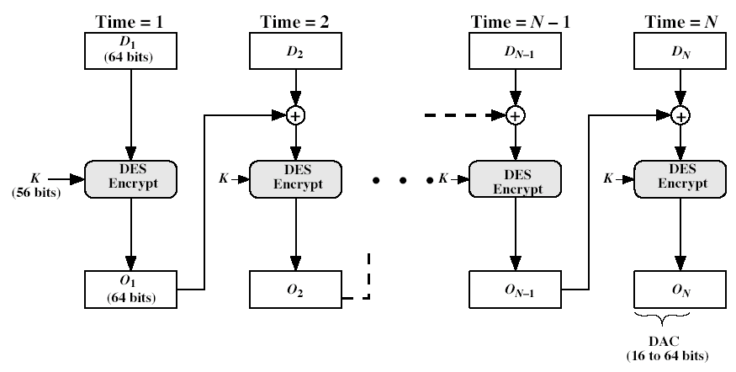
MAC based on DES
Data Authentication Code(DAC)

Slide 18
Hash Functions
A hash function is like a MAC
condenses arbitrary message to fixed size
  h = H(M)
usually assume that the hash function is public and not keyed
  -note that a MAC is keyed
hash used to detect changes to message
can use in various ways with message
most often to create a digital signature
Notes:
A variation on the message authentication code is the one-way hash function. As with the message authentication code, a hash function accepts a variable-size message M as input and produces a fixed-size output, referred to as a hash code H(M). Unlike a MAC, a hash code does not use a key but is a function only of the input message. The hash code is also referred to as a message digest or hash value.

Slide 19
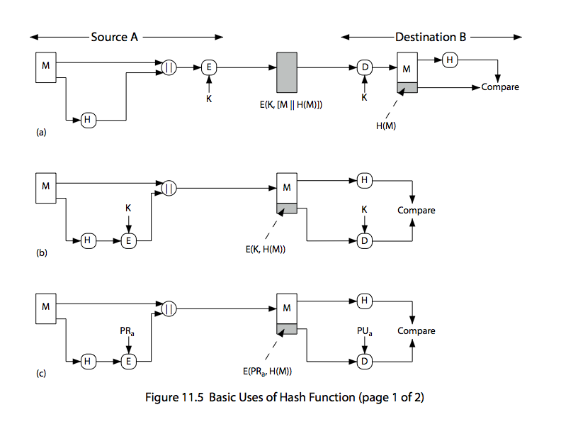
Hash Functions & Digital Signatures
Notes:
Stallings Figure 11.5c “Basic Uses of Hash Functions” shows the hash being “signed” with the senders private key, thus forming a digital signature.

Slide 20
Requirements for Hash Functions
can be applied to any size message M
produces a fixed-length output h
One-way Property
  given h is infeasible to find x s.t. H(x)=h
weak collision resistance
  for any given block x, it is computationally infeasible to find y ≠ x with H(y) = H(x)
strong collision resistance
  computationally infeasible to find (x,y) such that H(x) = H(y)
Notes:
The purpose of a hash function is to produce a “fingerprint”of a file, message, or other block of data.
These are the specifications for good hash functions. Essentially it must be extremely difficult to find 2 messages with the same hash, and the hash should not be related to the message in any obvious way (ie it should be a complex non-linear function of the message). There are quite a few similarities in the evolution of hash functions & block ciphers, and in the evolution of the design requirements on both.

Slide 21
Simple Hash Functions
are several proposals for simple functions
based on XOR of message blocks
-divide the message into equal size blocks
-perform XOR operation block by block
-final output is the hash
not very secure
need a stronger cryptographic function (next chapter)
Notes:
All hash functions operate using the following general principles. The input (message, file,etc.) is viewed as a sequence of n-bit blocks, processed one block at a time in an iterative fashion to produce an n-bit hash function. Can construct a range of possible simple hash functions by just XOR’ing blocks with rotates etc. None of these are secure, since can predict how changes to message affect the resulting hash.

Slide 22
Block Ciphers as Hash Functions
can use block ciphers as hash functions
  using H₀=0 and zero-pad of final block
  compute: H_{i} = E_{Mi} [H_{i-1}]
  and use final block as the hash value
  similar to CBC but without a key
resulting hash is too small (64-bit)
  Vulnerable to attacks
Notes:
A number of proposals have been made for hash functions based on using a cipher block chaining technique, but without the secret key (instead using the message blocks as keys). Unfortunately these are subject to both the birthday attack, and to a “meet-in-the-middle” attack. Thus, attention has been directed at finding other approaches to hashing.

